Slide 1
CSE 109 Electrical Circuits
Dr. Md. Forkan Uddin
Associate Professor
Department of Electrical and Electronic Engineering (EEE)
Bangladesh University of Engineering and Technology (BUET)

Slide 2
AC Circuits: Phasors (Chapter 9 – Alexander)

Slide 3
Phasor
What is a phasor?
A complex number that represents the amplitude and phase of a sinusoid
Phasors are more convenient to work with
Phasors are written in bold face
v(t) = V_{m} sin(ωt ± θ )
(Time-domain representation)
(Phasor-domain / Frequency Doamin representation)

Slide 4
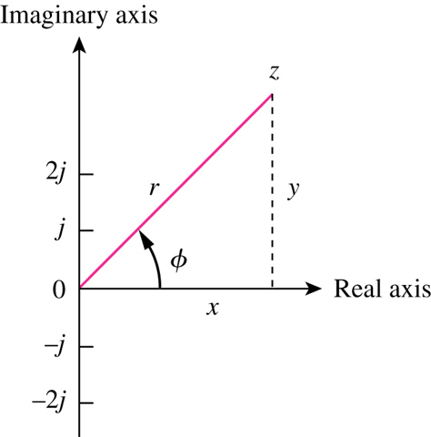
Complex Number
Complex number can be written in rectangular form:
Z = x + j y
where:
x = real part of z
y = imaginary part of z
θ
Rectangular /Cartesian form
Polar form
Exponential form

Slide 5
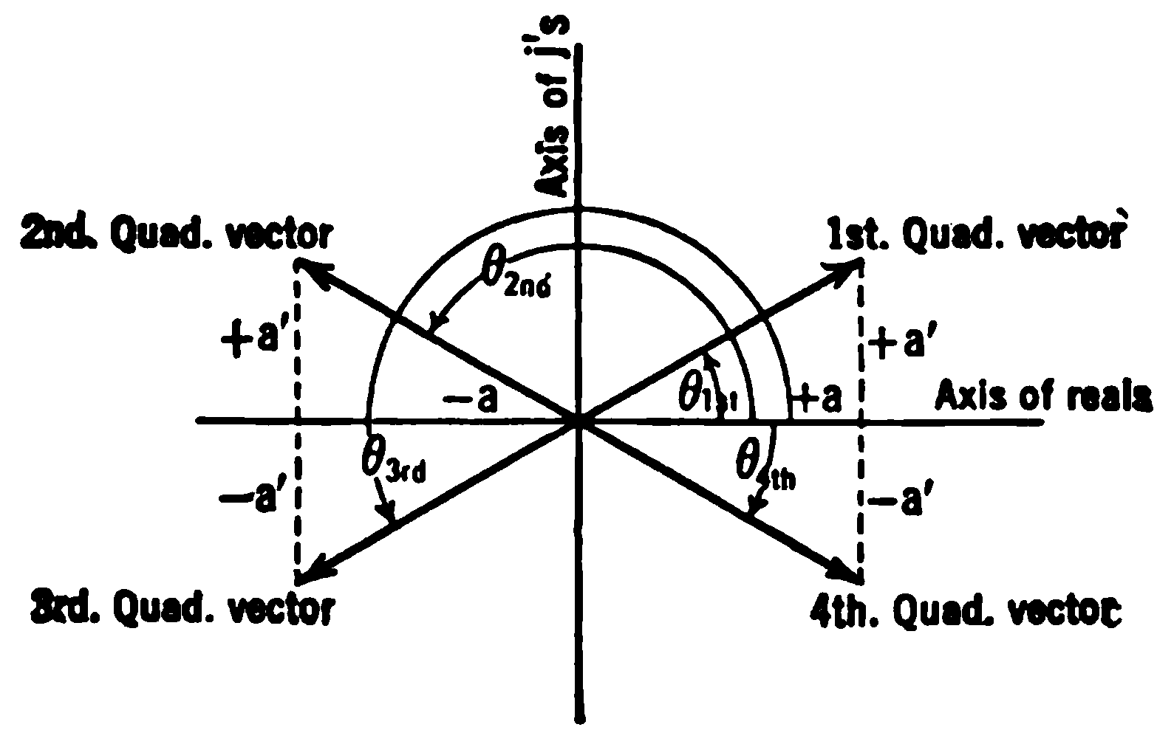
Complex Number
Given x and y:
1st & 4thquadrant
2nd & 3rd quadrant
Given r and θ:
x = r cos θ and y = r sin θ

Slide 6
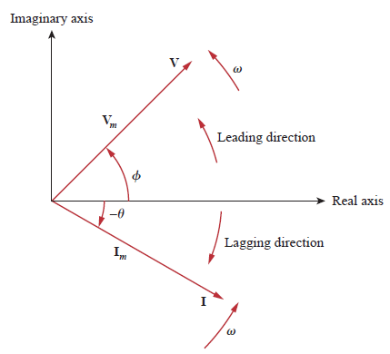
Sign Convention for Phase Angle
Reference axis: angle = 0º
CCW: +ve angle
CW: -ve angle

Slide 7
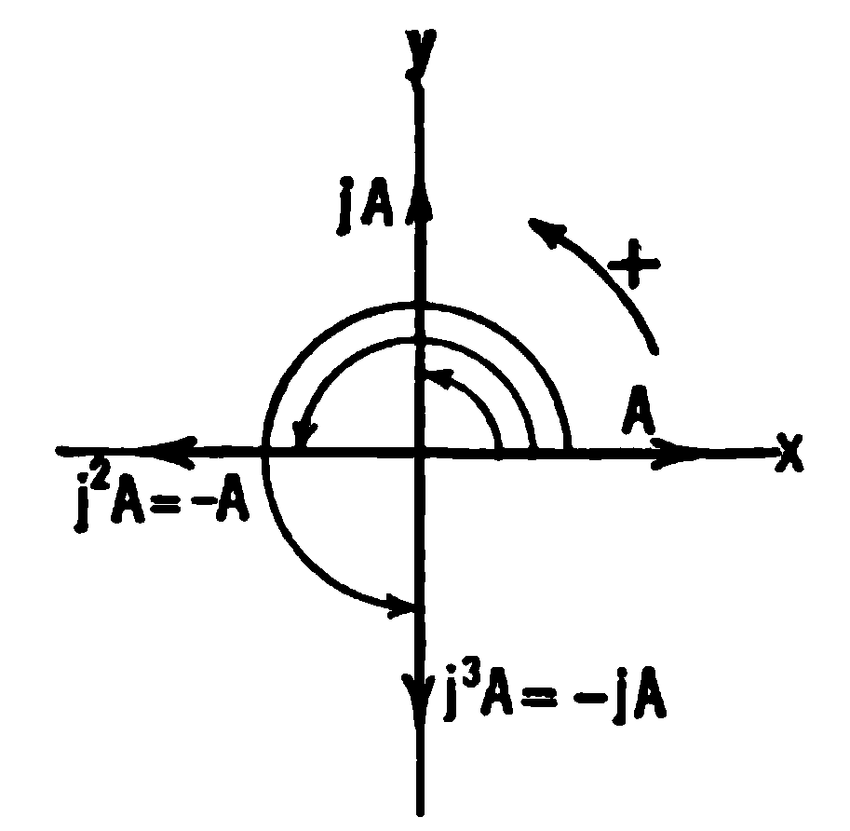
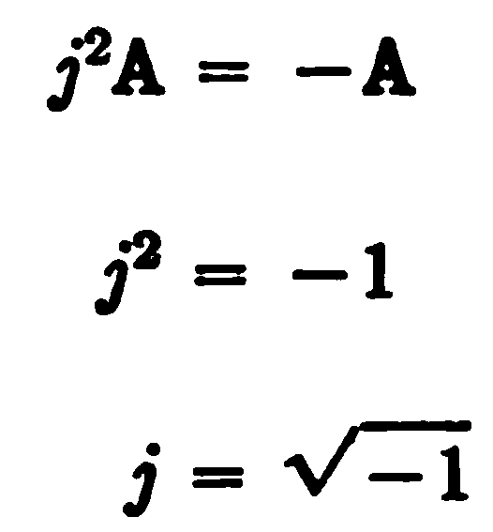
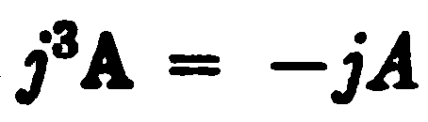

Operator j
Operator ‘j’
produces 90º CCW rotation of any vector to which it is applied as a multiplying factor

Slide 8






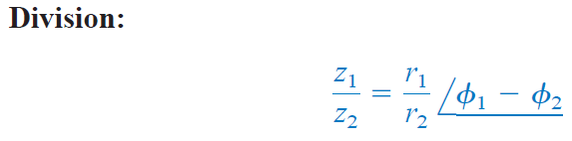
Phasor Algebra
Let, , ,

Slide 9
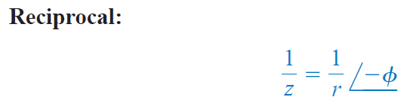

Phasor Algebra
n-th Power
n-th Root
Logarithm
Φ in radian

Slide 10
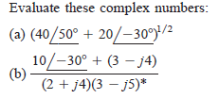
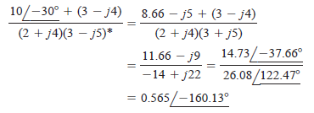
Example
(b)

Slide 11
Example
A
A
A
A

